Slide 1
a P.A.T to Boost Effective learning and assessment

Slide 2
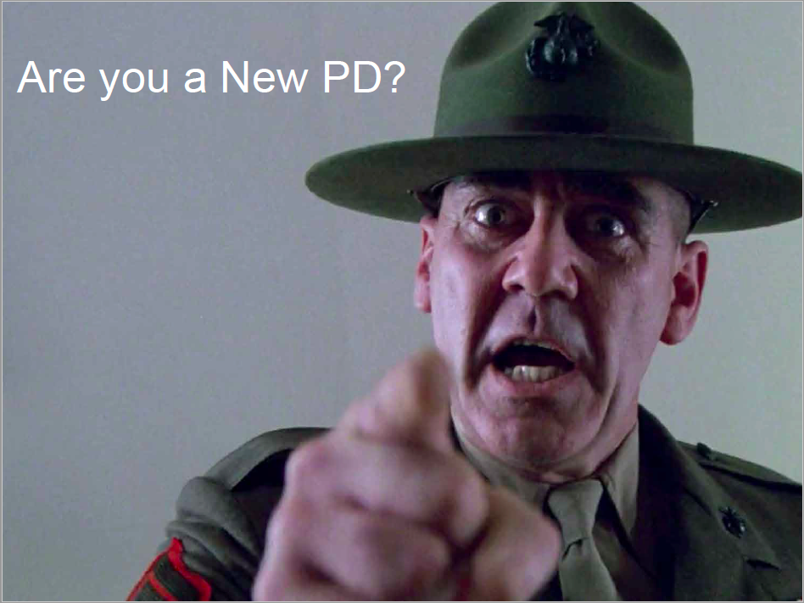
2-Yr Residency: Capturing the journey
Know Who You Are, Be Who You Are, Show Who You Are. Gisondi and Branzetti

Slide 3
CODA Standard. 1:
Has the program developed clearly stated goals and objectives appropriate to advanced specialty education, addressing education, patient care, research and service?
YES

Slide 4
PROGRAM Objectives
To prepare residents for a board-based career in private practice and/or academics with emphasis on advocacy and community engagement.
To produce proficient, conscientious, evidence-based clinicians, dedicated to a lifetime of professional development and learning.
To provide empathetic quality care to patients
To prepare graduates for achieving certification by American Board of Pediatric Dentistry.
To prepare residents to participate in research, scientific writing, and case presentation.
To maintain a cost-effective postgraduate program

Slide 5

OUTCOME ASSESSMENTS
QUALITATIVE
Research
Mock Boards
Essential Trainings
6 Month evals
Course evals
The
ASSESSMENT
of
OUTCOMES
Attendance
RCL
Rotations
On-Call
QE
In-Service
QUANTITATIVE

Slide 6
Are all residents achieving superior level clinical proficiency?
The Tool needs to:
Be friendly and informative
Be chair-side
Provide a rubric to do better
Promote self-assessment
Capture progression
Engage faculty
Be an effective teaching tool/communication tool
CORE VALUES
CODA
SUPERIOR PROFICIENCY

Slide 7
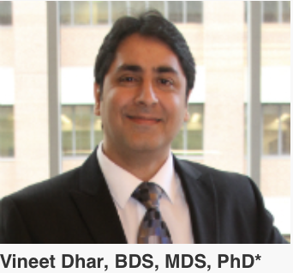
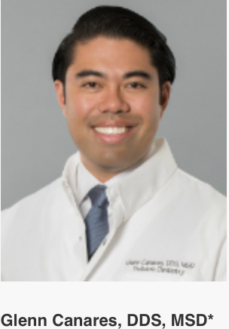
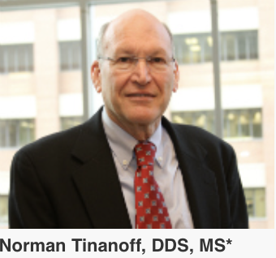
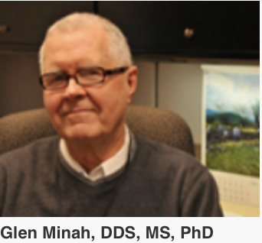
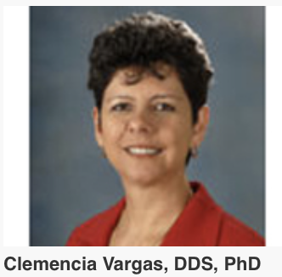
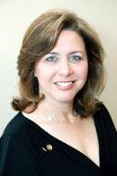
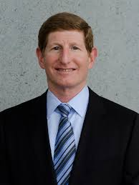

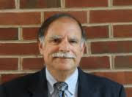
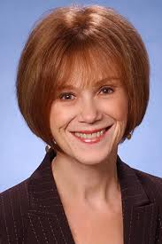
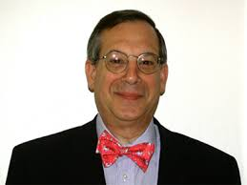

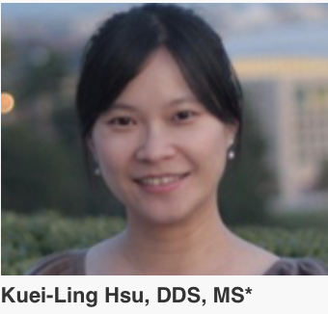
Calibrated Faculty
Shari Kohn, DDS
Ed Ginsberg, DDS
Jim Coll, DDS, MS
Barry Cohan, DDS
Sue Seale, DDS, MS
Warren Brill, DDS,MS
Abdullah Marghalani, DDS

Slide 8
OUTCOME ASSESSMENTS
QUALITATIVE
Research
Mock Boards
Essential Trainings
Course evals
P.A.T
The
ASSESSMENT
6 Month evals
of
OUTCOMES
Attendance
RCL
Rotations
On-Call
QE
In-Service
QUANTITATIVE

Slide 9
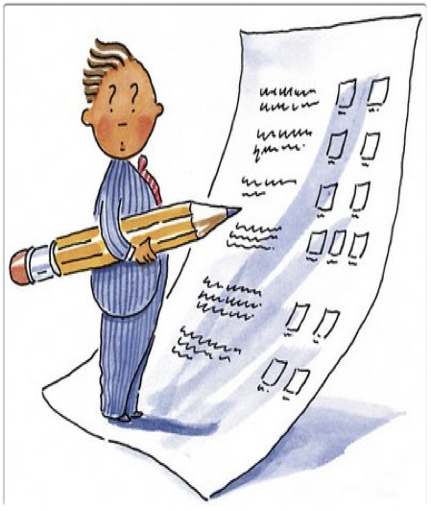
Progressive Assessment toolS
CHairside
assessment tool

Slide 10
OBJECTIVES
Improve faculty interaction, standardization, and quality feedback
Increase self-learning and self-assessment
Increase understanding of critical errors and superior performance
Improve organizations skills and patient preparedness
Improve presentation skills

Slide 11
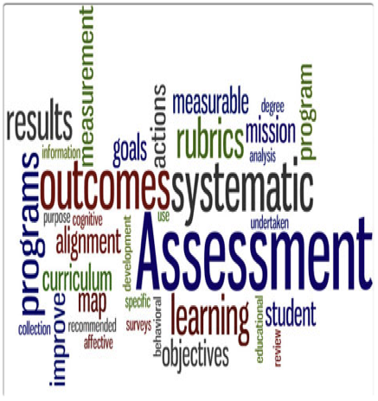
P.A.T for various clinical procedures
Diagnosis & Treatment Planning
Prevention
Restorative
Pulp Therapy
Anxiolysis Using Nitrous Oxide
Exodontia
Space Management
Sedation
Operating Room

Slide 12
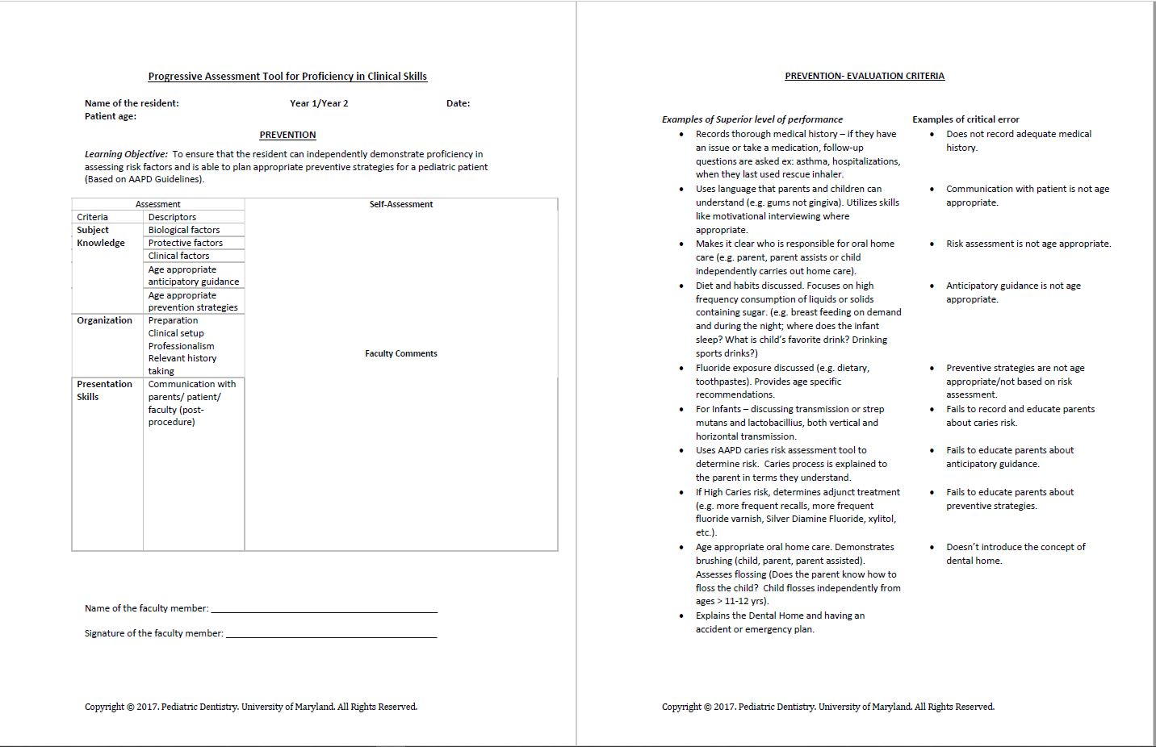
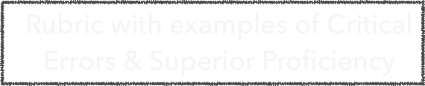
Progressive assessment tool
Evaluation OF:
Subject Knowledge
Organization Skills
Presentation Skills

Slide 14
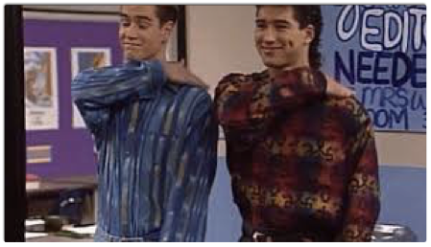

P.A.T yourself
P.A.T by faculty

Slide 15
0
Essential trainings Course List
Goals and pre-assessment questionnaire
In-Service Exam
START
Evaluation
RCL
Self Appraisal
Mock-Boards P.A.T
6
3
Evaluation
RCL
Mock-Boards P.A.T
18
Research
Q & A sessions
12
21
In-Service
QE
Research Poster
Annual Evaluation
RCL
Mock-Boards P.A.T
24
Summative Evaluation
Exit Interview
Mock Board
RCL
P.A.T
FINISH
Residency roadmap

Slide 16
Calibration and Tool Validation
Construct Validation (Structure): Faculty Calibration
Content Validation (Rubric): Faculty Calibration
Inter-Examiner Consistency: Constructive Feedback Guide
Pilot Testing: Resident/Faculty Use in Clinic
Suggestions/Amendment: Continual Feedback Process

Slide 17
Constructive Feedback
Purpose: | To maximize student learning in a way that facilitates corrections and improvements.
Key elements: | | Timely | Specific | Encouraging | Purposeful | Relevant | Tailored | Factual | Descriptive |

Slide 18
 |  | Steps to follow when discussing the P.A.T.
1 | Listen. | • Ask the resident to describe what he/she did well and did not do well. • Ask the resident how it may have affected the clinical procedure.
2 | Describe your observations. | • State actions the residents performed well and poorly. • Focus on describing how skills were performed, not personal qualities of the resident. • Be SPECIFIC.
3 | Describe your thinking. | • Explain what aspects of the procedure were most important to success. • Provide examples of potential consequences of the actions performed.
4 | Suggest a skills-based development plan. | • Provide SPECIFIC learning activities and techniques that help increase skill performance. • Set a milestone that resident can use to self-assess during development. • Encourage the resident.

Slide 19
 | Examples of good feedback:
Positive Constructive Feedback: | “I was pleased to see how efficiently you completed the crown prep. You transitioned well from occlusal reduction to beveling to interproximal slices. The smooth transition allows for a better patient experience. Going forward, focus on preparing as much of the tooth with one bur before changing. You’ll find your total prep time decrease. Well done.”
Negative Constructive Feedback: | “I think the patient had difficulty during the crown prep because you were preparing the same surfaces in rapid, short bursts. This makes the procedure more uncomfortable for the patient and it takes more time. In the future, focus on using well-controlled, efficient strokes to remove tooth structure. Practice on getting down to 1 or 2 strokes per surface. I’m confident that you will be able to do it.”

Slide 20
 | Examples of poor feedback:
Positive Feedback: | “You’re a natural when prepping crowns. Private practice will go well for you.”
Negative Feedback: | “That crown prep was a mess. Be more confident and try harder next time.”

Slide 21
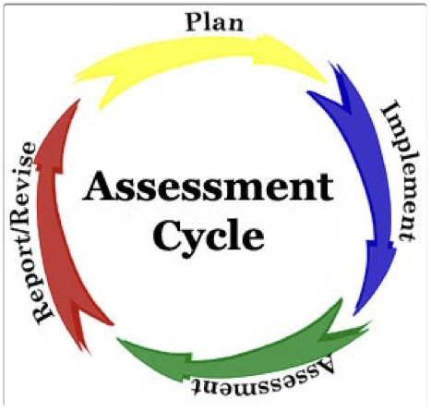
Effectiveness of P.A.t
Anonymous Resident Survey

Slide 22
Objective: PAT as a learning/Assessment tool

Slide 23
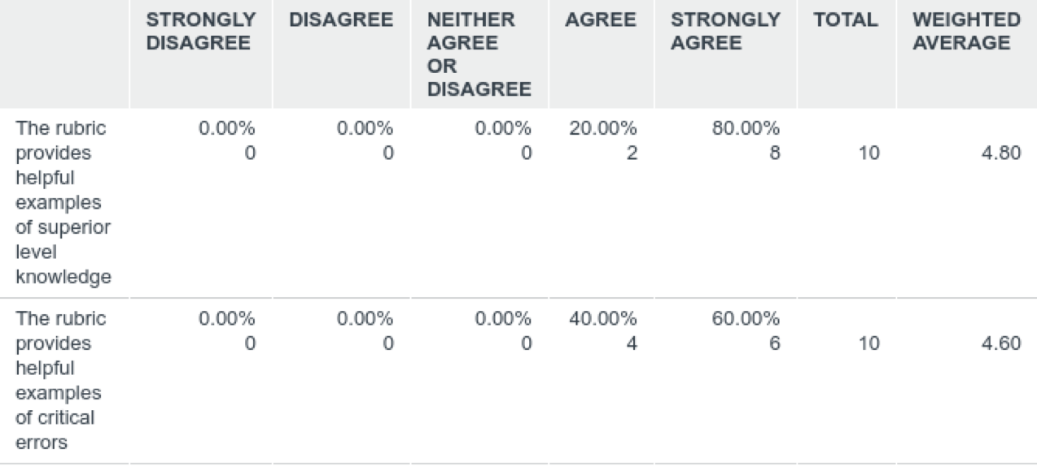
Q1: P.A.T as an effective tool for improving subject knowledge of the clinical procedure.

Slide 24
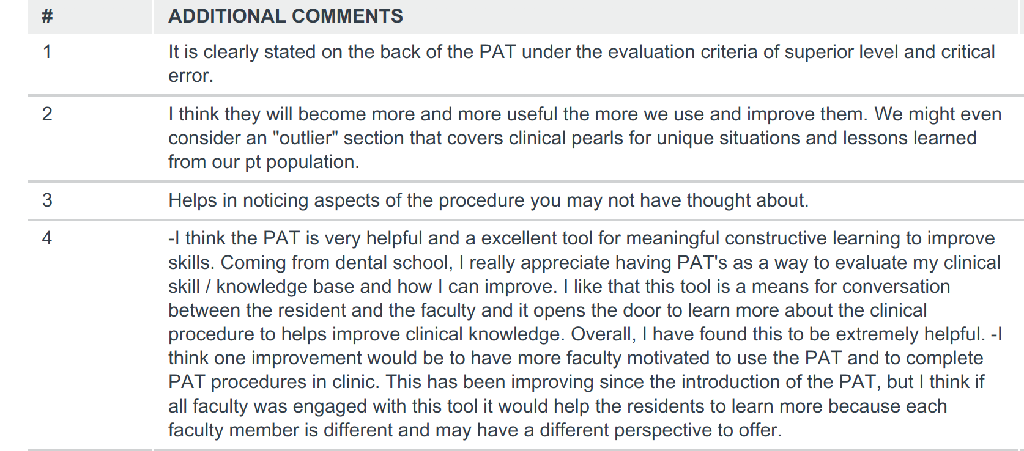
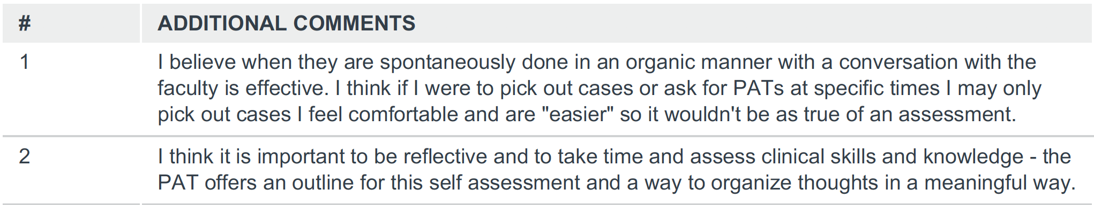

Slide 25
Objective: PAT to improve Faculty interactions

Slide 26
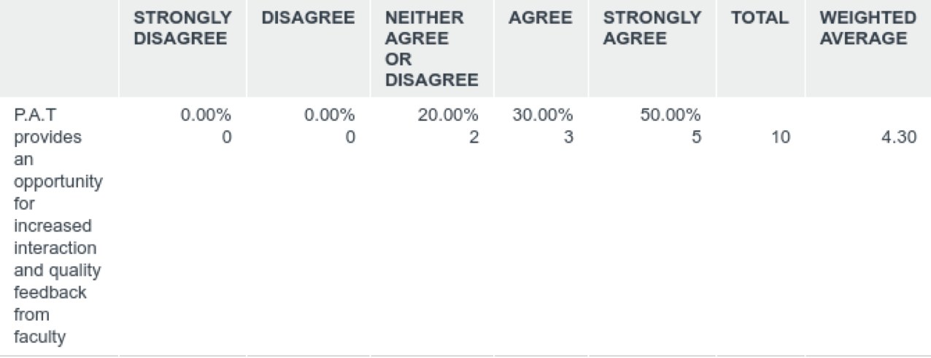
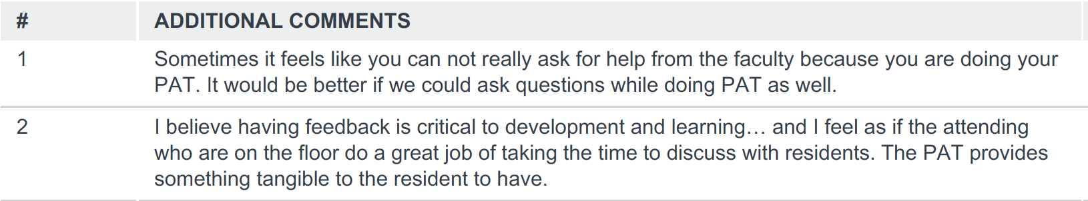
Q2: P.A.T as an effective tool to improve faculty interactions

Slide 27
Objective: PAT to improve organizational and presentation skills

Slide 28
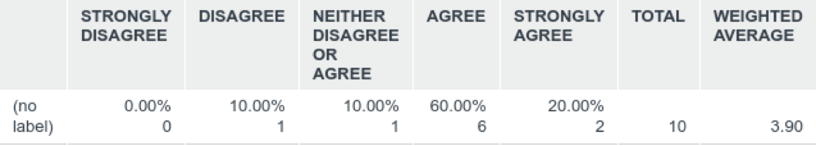
Q3: P.A.T has helped me to become more organized while providing care for my patients.

Slide 29
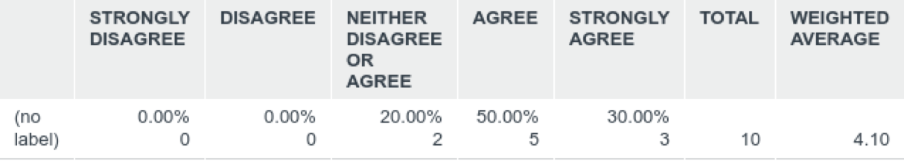
Q4: P.A.T has helped me improve my presentation skills (while presenting clinical cases).

Slide 30
Overall effectiveness

Slide 31

Q5: P.A.T as an effective tool for improving overall clinical proficiency

Slide 32
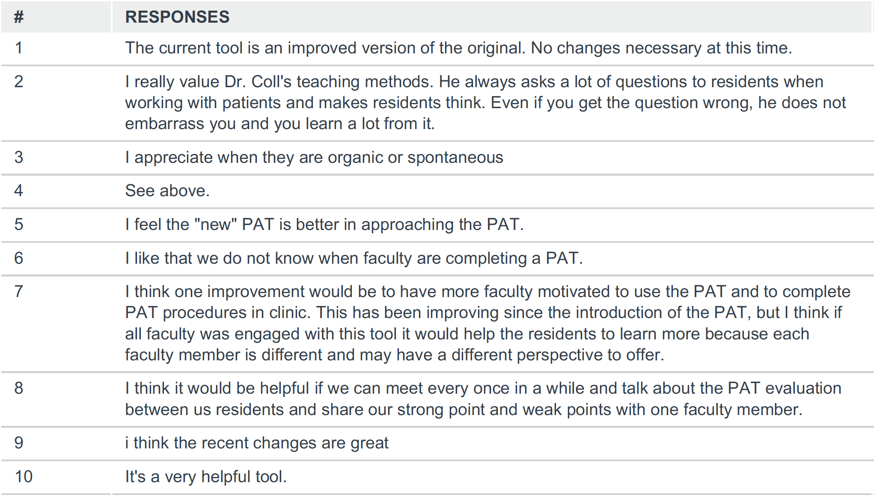
Q 6. Any suggestions to improve the PAT process and/or the tool itself?

Slide 33

`OBJECTIVES Met’- as ranked by residents
Increased self-learning and self-assessment
The rubric as a resource for examples of critical errors and superior performance
Improved faculty interaction, standardization, and quality feedback
Improved organizations skills and improved presentation skills
2
3
4

Slide 34
STRENGTH
WEAKNESS
Stimulates:
Prior preparation/readiness
Faculty/resident interaction
Time and resources
SWOT
OPPORTUNITY
THREAT
To help all residents achieve superior level clinical proficiency
Can be perceived as competency

Slide 35
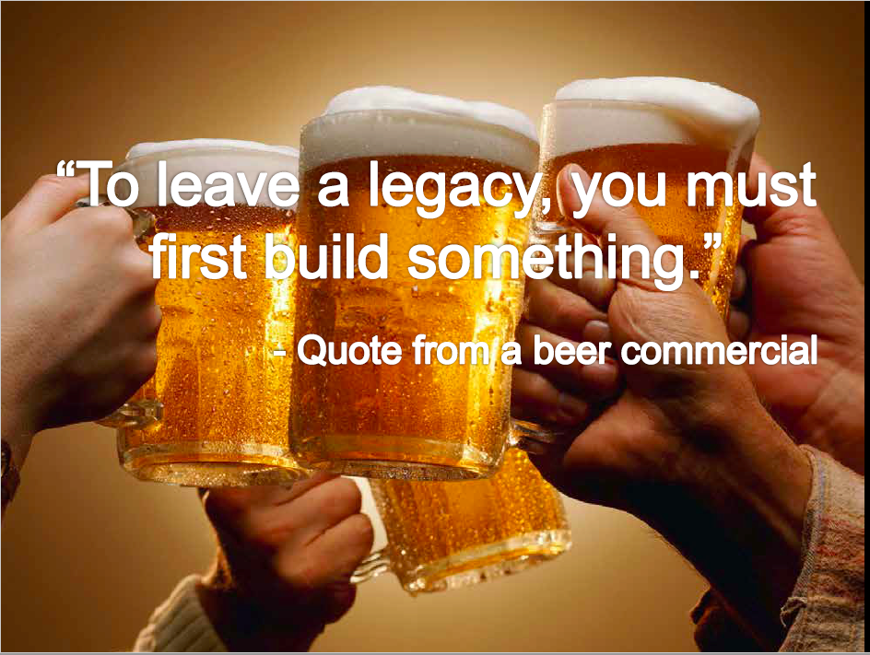
THANK YOU!
Know Who You Are, Be Who You Are, Show Who You Are. Gisondi and Branzetti

