Slide 1
Utilizing Photos in T4: Part One
Implementing a three-column staff page and using thumbnail items

Slide 2
Presentation overview
Review of the problems with the current format of staff pages in T4.
Using Pixlr to crop and resize photos for T4 content types
Implementing a three-column staff page with a lead photo
Implementing a thumbnail list item

Slide 3
Problems with existing staff pages
When UMB switched to the T4 system, Dentistry implemented new staff pages in a table format within the general content type.
A table format is unintuitive and results in spacing and alignment inconsistencies.

Slide 4
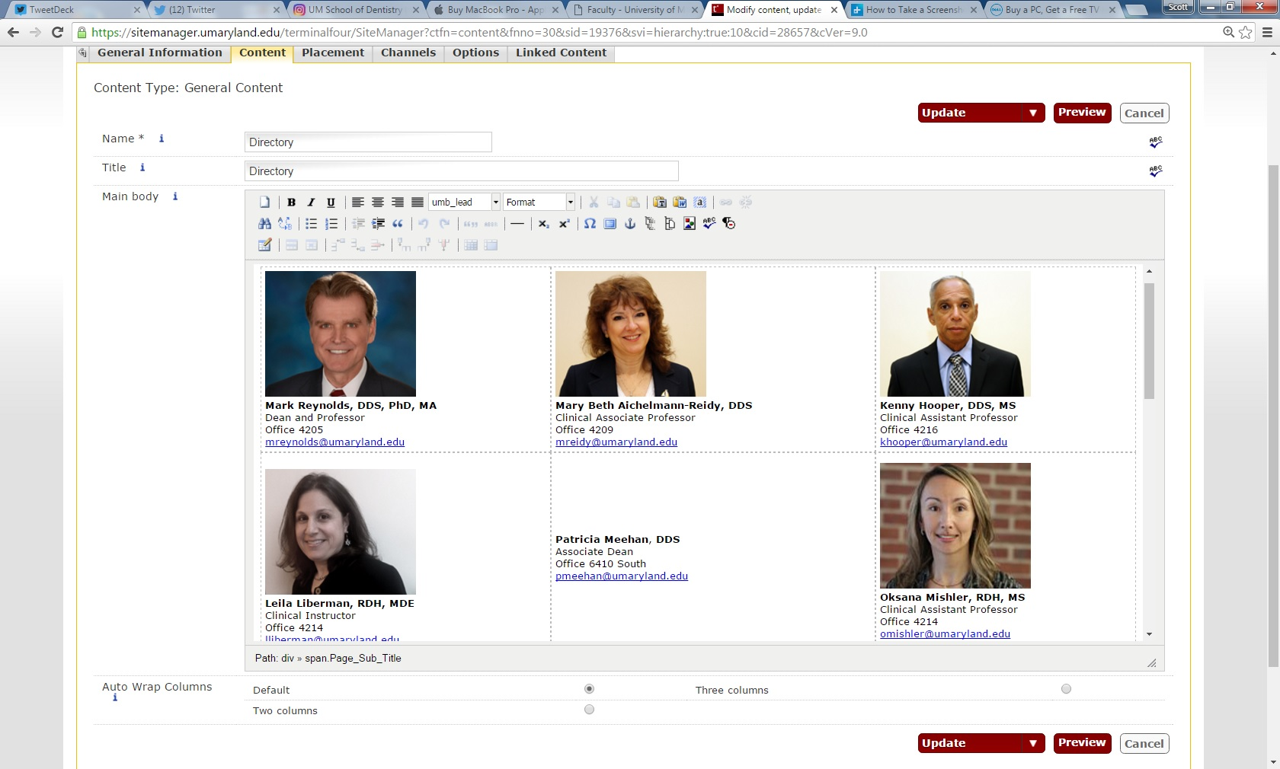
Problem with existing staff pages: table grid example

Slide 5
Using Pixlr to edit photos
We need to convert our existing staff pages to picture-friendly T4 content types.
The three-column format is the simplest option.
In order to utilize this format, moderators need to crop and edit headshot photos before uploading them into the media library.
Currently, Pixlr.com is the most user-friendly program for editing photos .
The following visual guide will instruct you on how to use pixlr to edit photos.

Slide 6

Pixlr visual guide: open web apps page from pixlr hompage

Slide 7
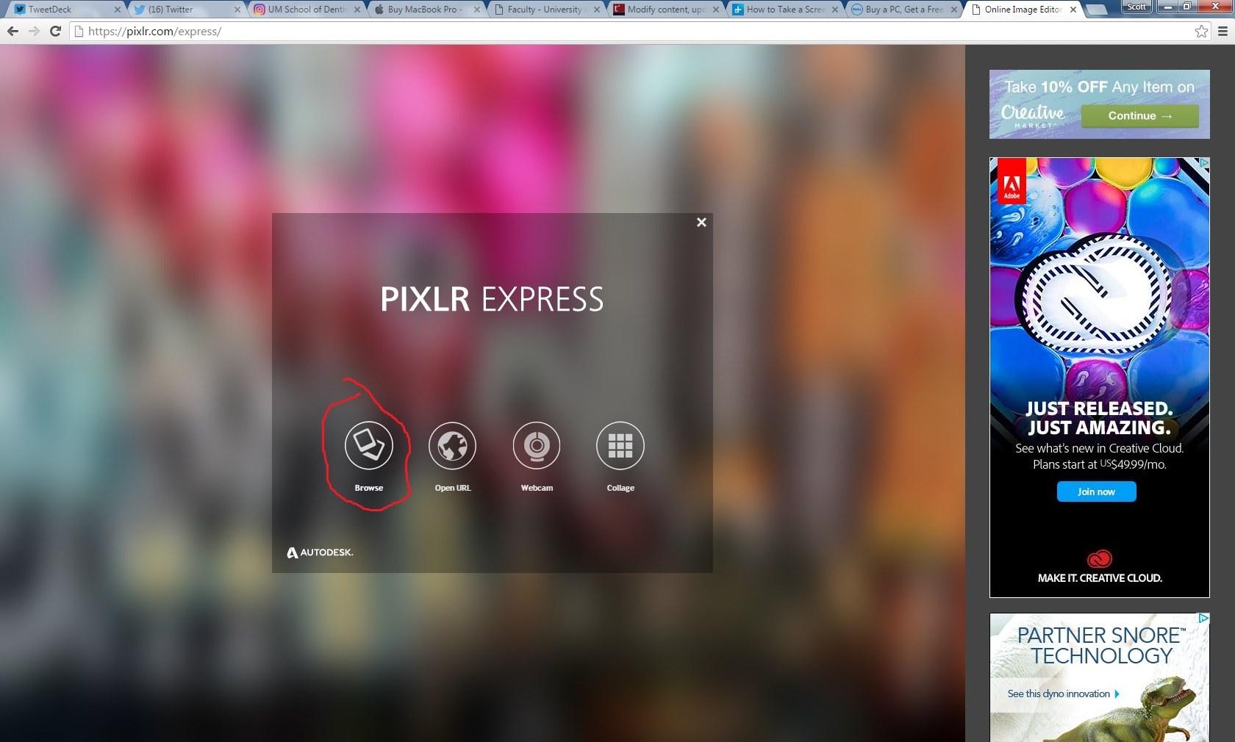
Pixlr visual guide: Opening file from the Web app

Slide 8
Pixlr and T4 editing conventions
Before we proceed with the rest of the visual guide, it’s important to highlight various standard photo dimensions.
For headshots on staff pages: use 180 by 144 px (width and length) size.
For full-page staff lead-in photos, we recommend 1024 px width and 576 px height (height should generally be in between 500 and 650 px).
For thumbnail lead-in photos, use 170 px by 113 px size.

Slide 9
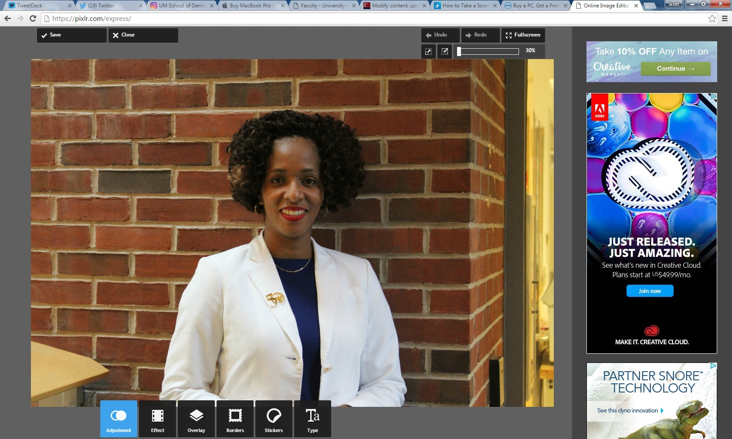
Pixlr visual guide: opening the adjustment menu

Slide 10
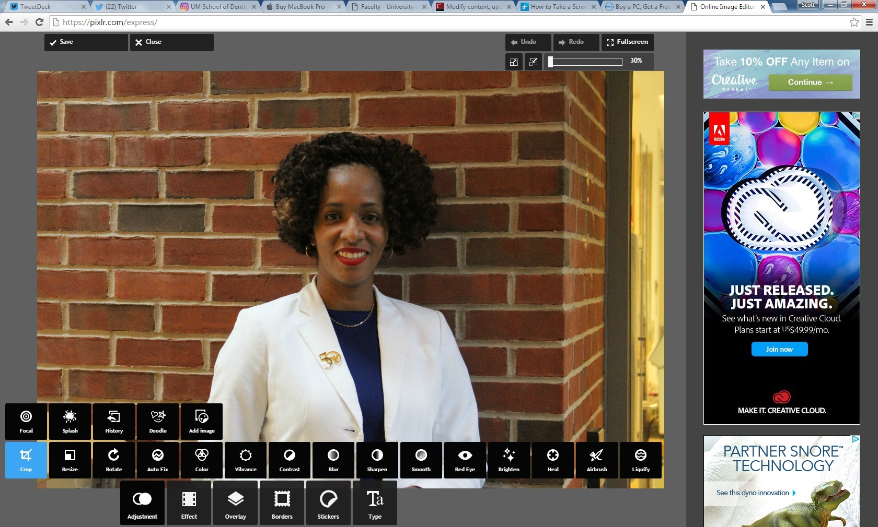
Pixlr visual guide: selecting the “crop” option

Slide 11
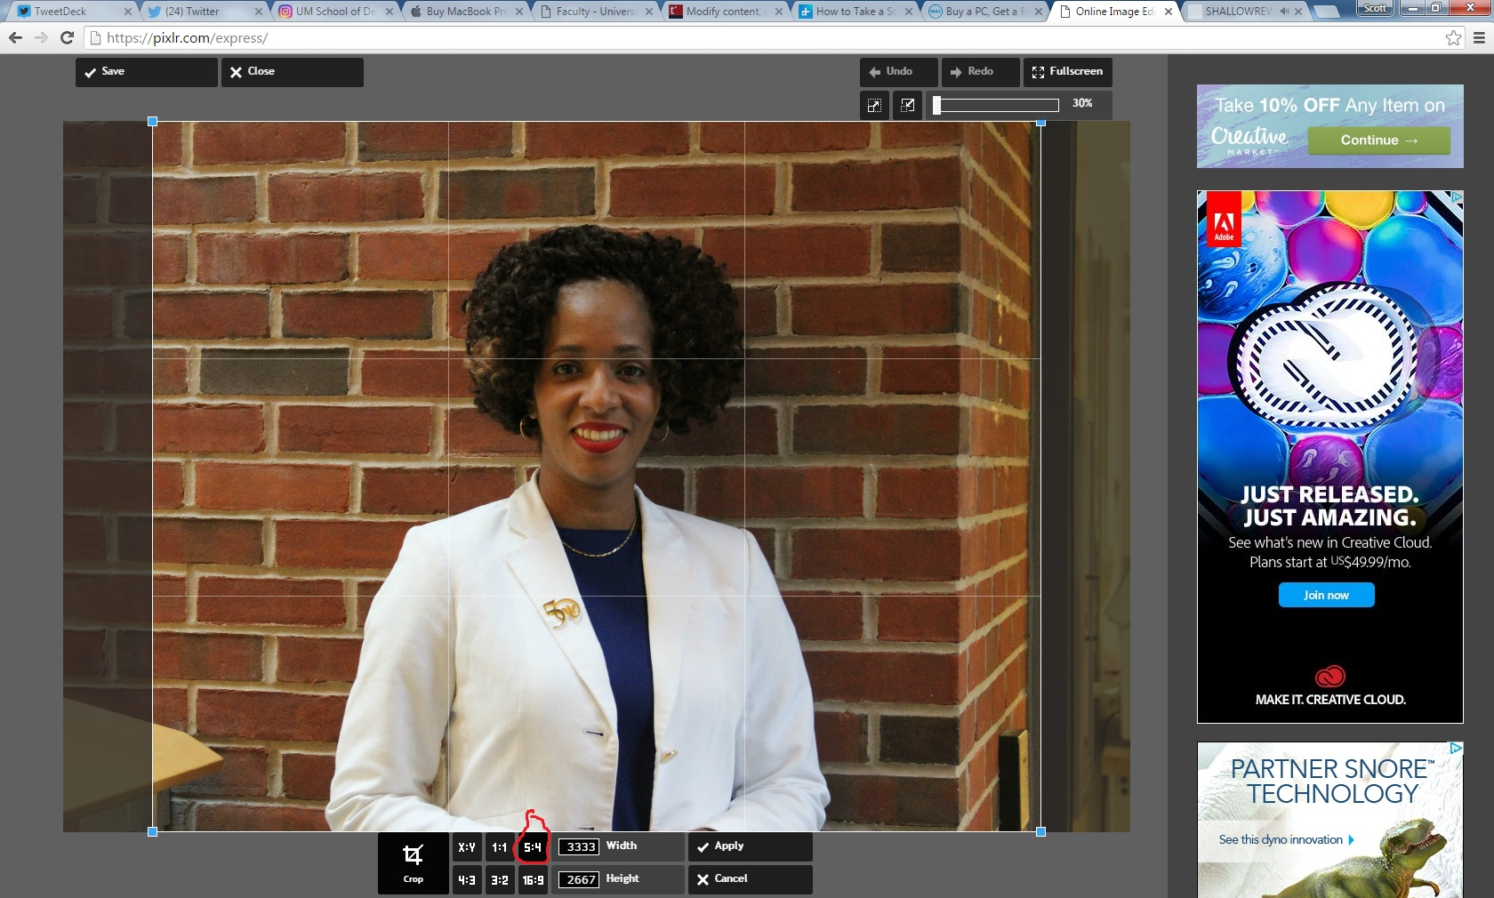
Pixlr visual guide: select and apply 5:4 crop for headshot photos

Slide 12
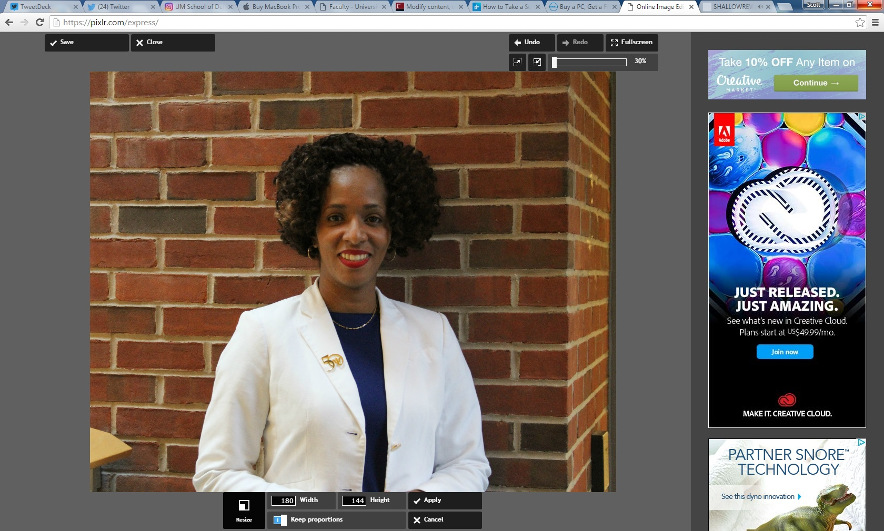
Pixlr visual guide: resizing photo to 180 px width after cropping (height will automatically adjust if you keep proportions).

Slide 13
Implementing the three-column page
After editing your photo in Pixlr, save it by clicking on the “save” option on the top right corner.
Enter your photo into the media library (you should have received instruction on using the media library during your T4 training).

Slide 14
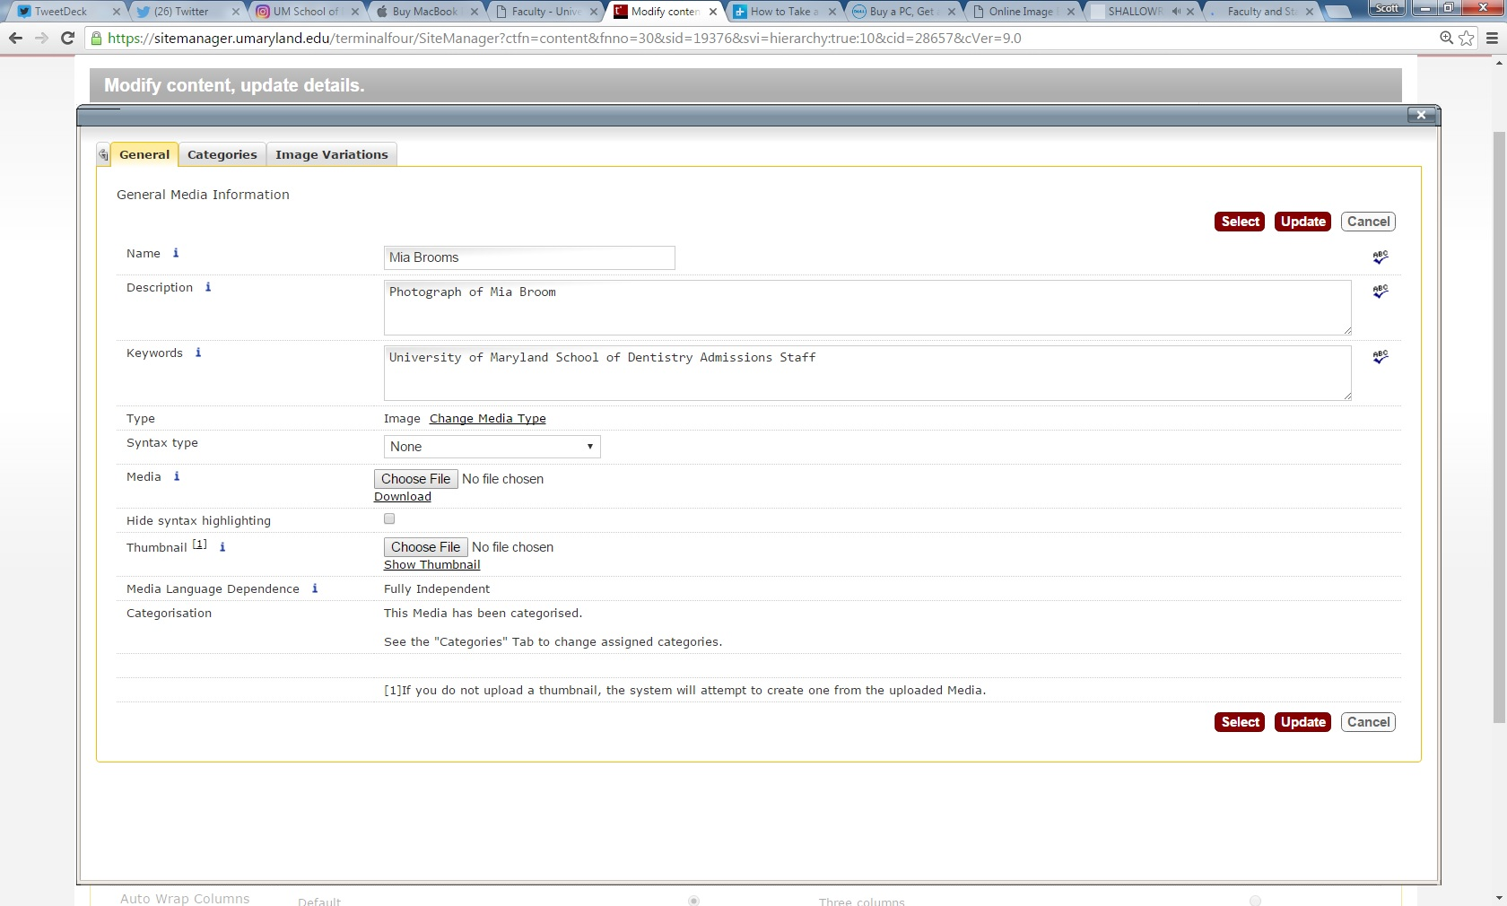
Three column visual guide: entering photo in media library

Slide 15
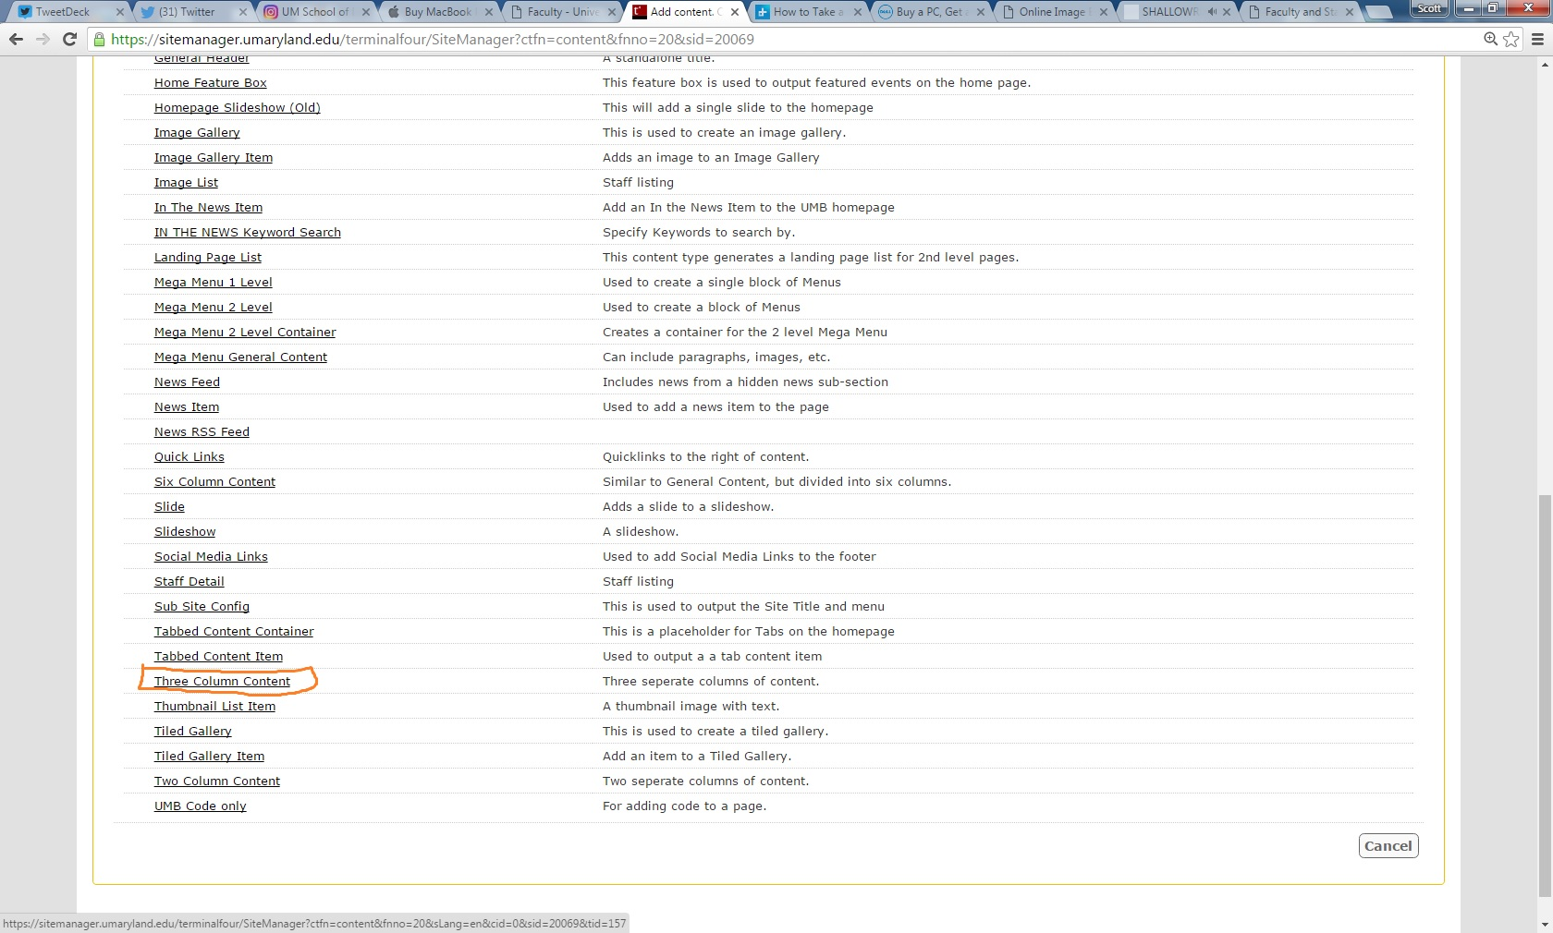
Three-column visual guide: content type page

Slide 16
Entering content into a three-column page
You have the freedom to adjust content on the three-column page: if you want the staff member’s name to appear above the photo, you can enter it in the column title. If you want the name below the picture, you can type it below the photo in the main body and leave the title blank.
Insert the photo from the media library into the main body.
The following page shows how to enter information into a column with the name above the photo.

Slide 17
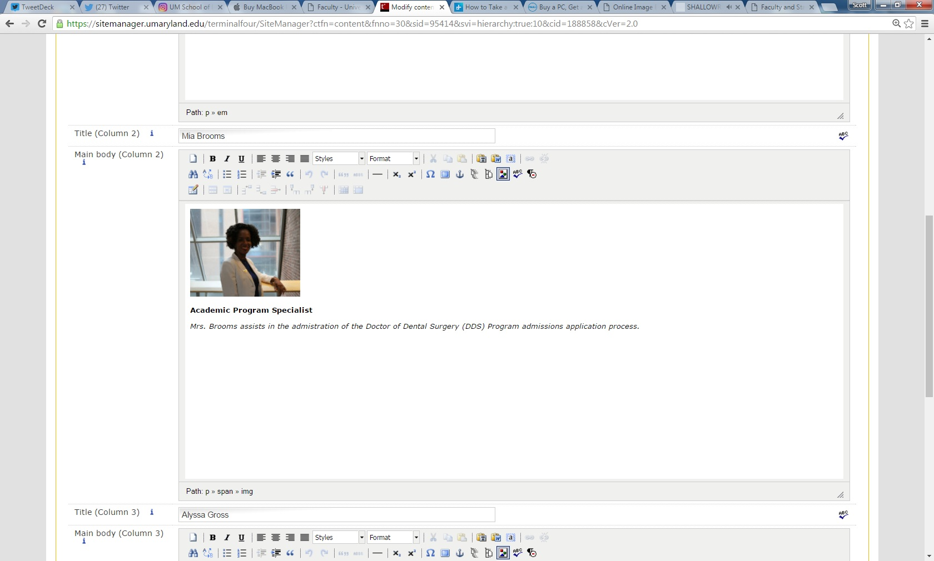
Three-column visual guide: entering content

Slide 18
Three-column content: final steps
Enter your staff into and photos into all three columns similar to what was outlined in the last slide.
If you want to add more staff members, simply add a new three column content type to the page.
Finally, you might want to add a large lead group photo of your staff (1024 px by 576 px). To do this, create a general content type and then insert the uploaded main photo

Slide 19
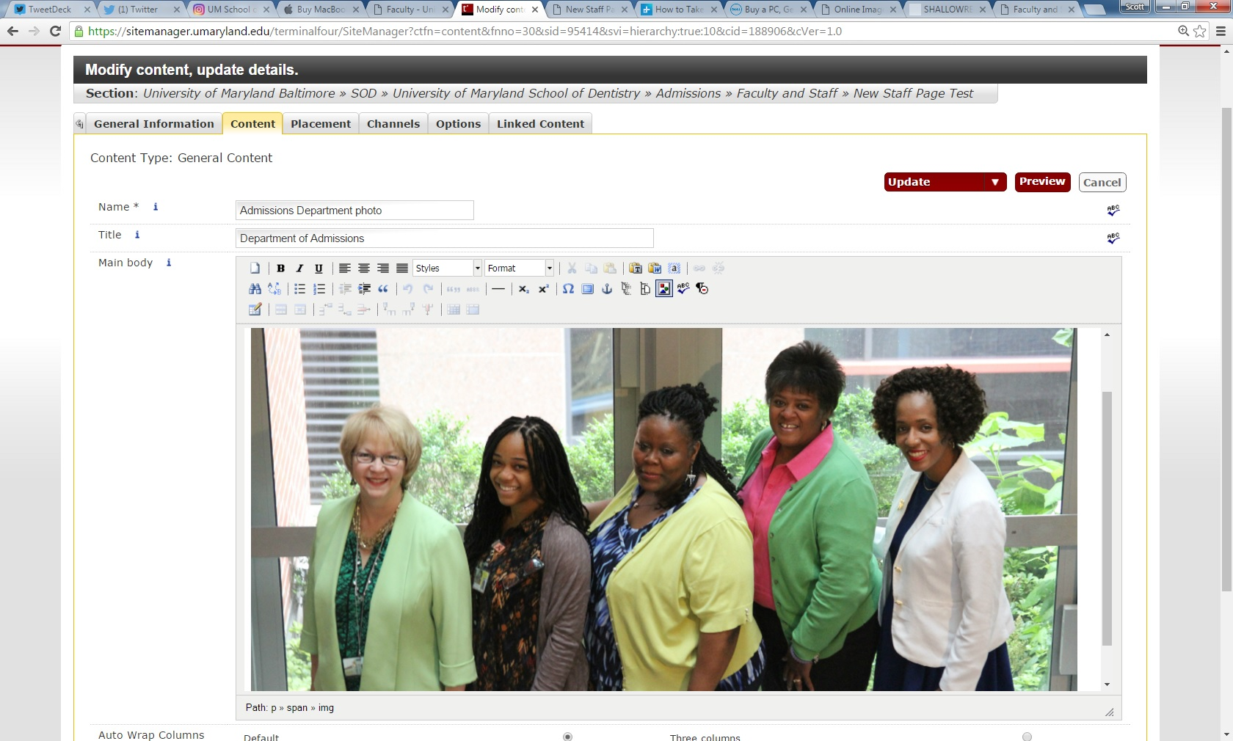
Main staff photo visual guide

Slide 20
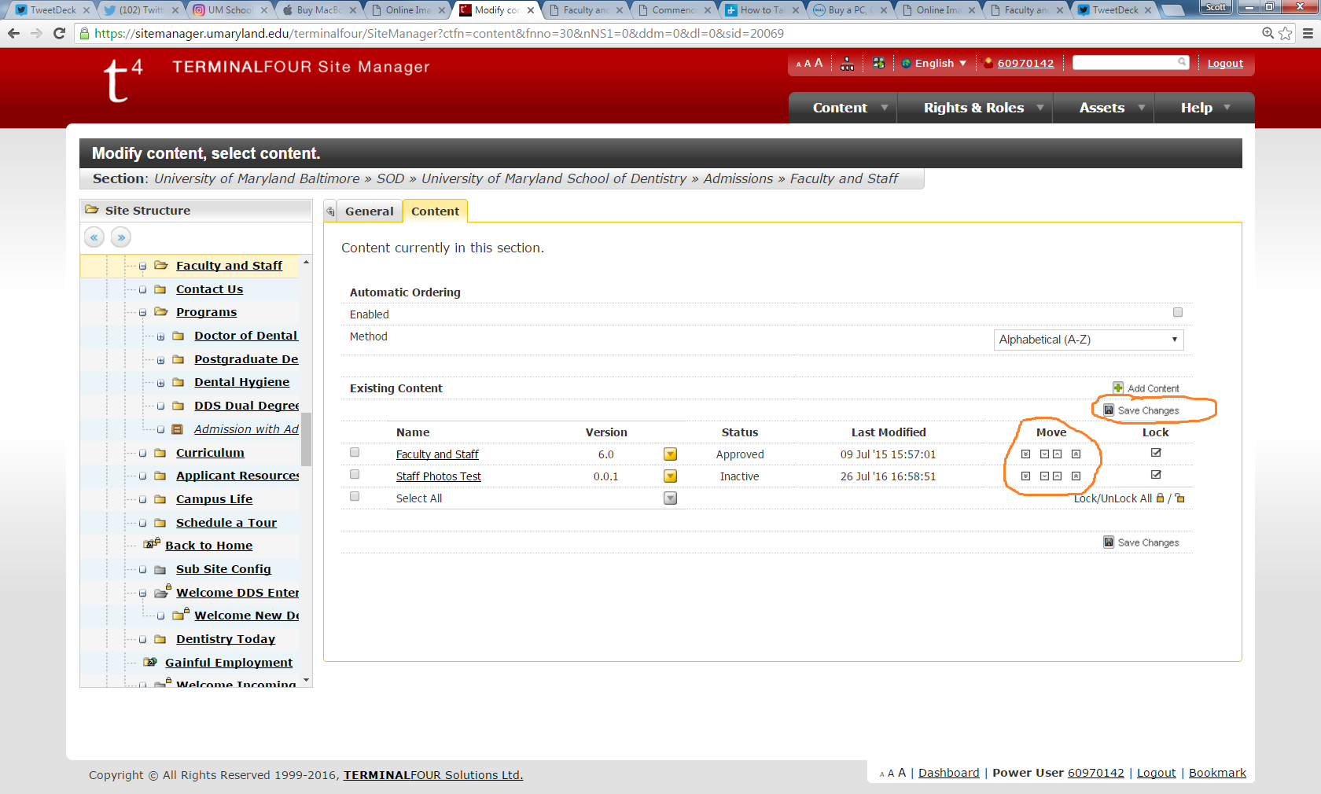
Make sure to adjust your content order so it appears correctly

Slide 21
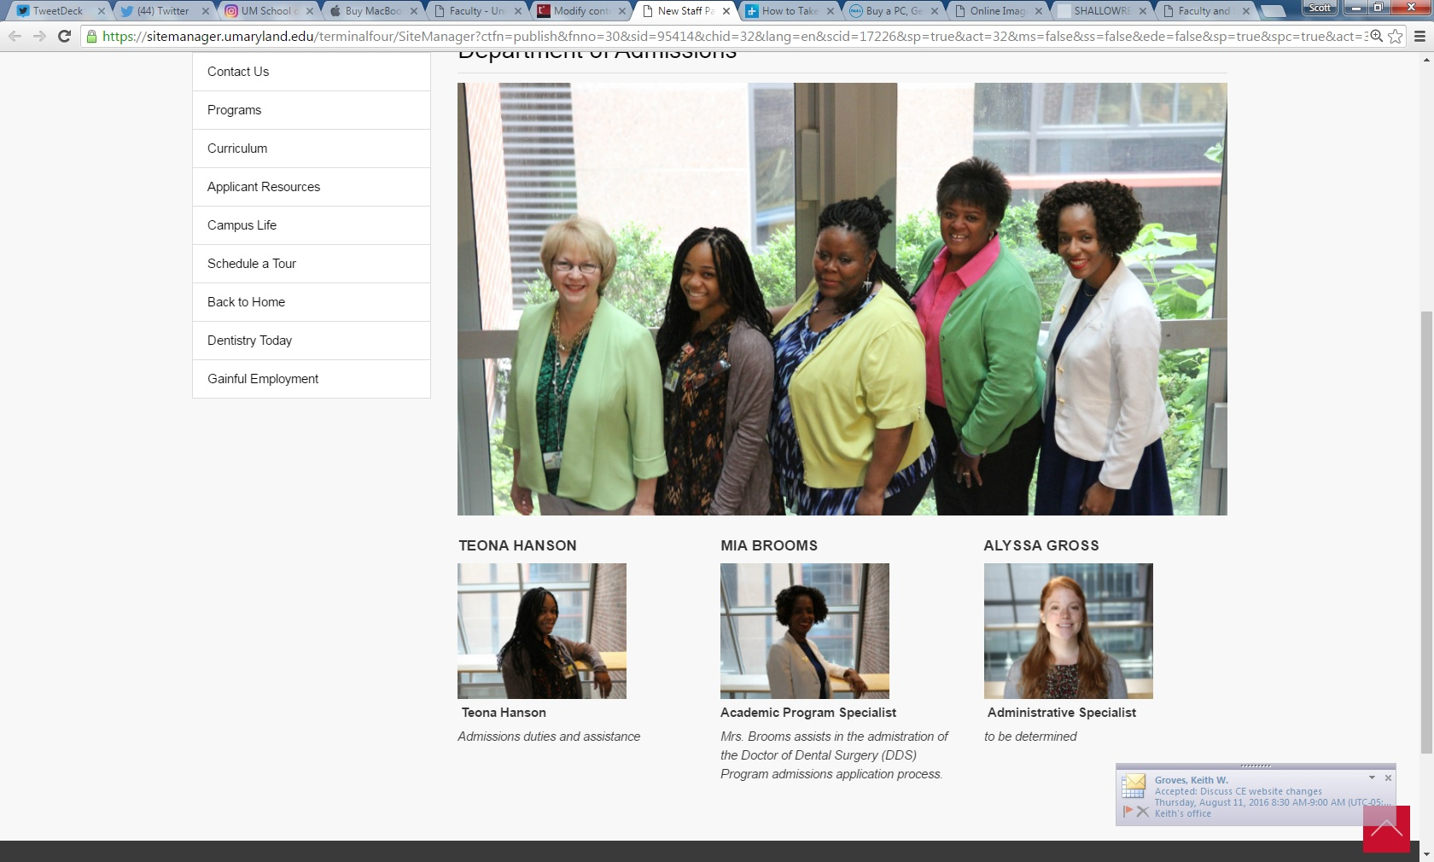
Now, let’s take a look at a preview of a three-column staff page with lead photo

Slide 22
Implementing a thumbnail item
Thumbnail items are another photo-based content type.
Thumbnail items can be used as lead-in teasers to more expanded content, such as articles and publications and photo galleries. Technically, they can also be used to create a staff page, but they are more cumbersome than three-column content types because you have to enter each individual item instead of three at a time.

Slide 23
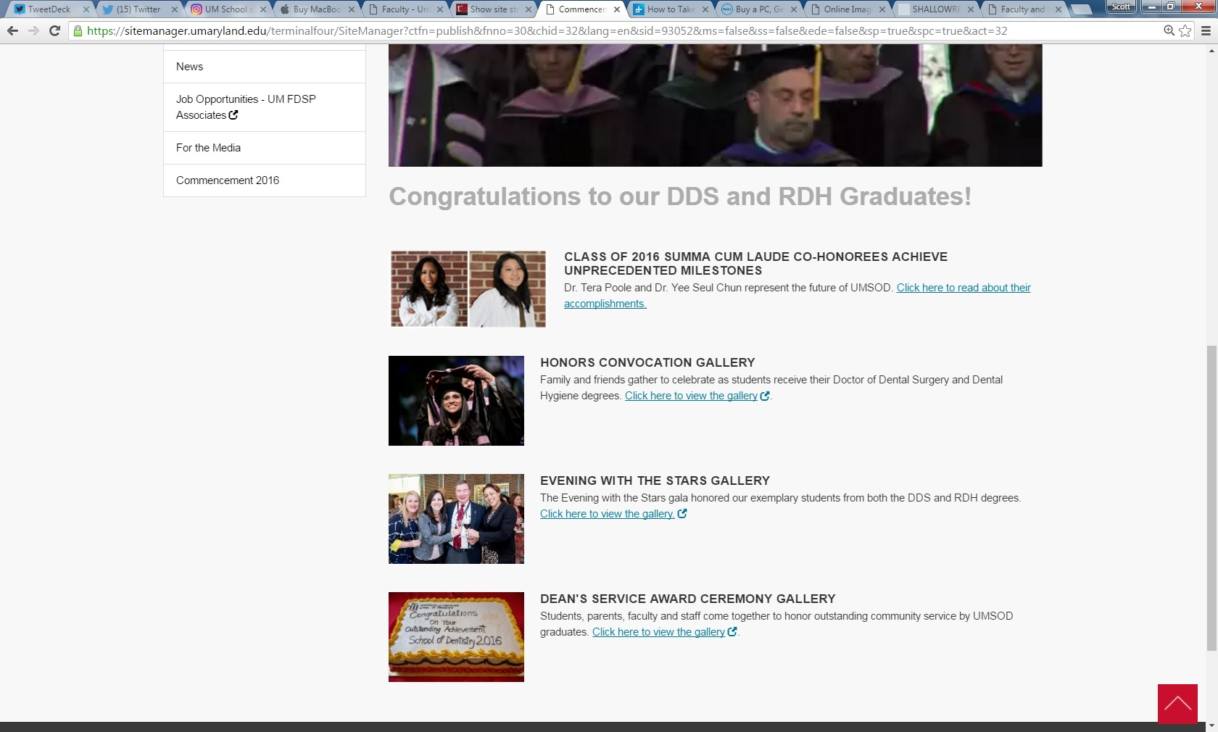
Thumbnail visual guide: example

Slide 24
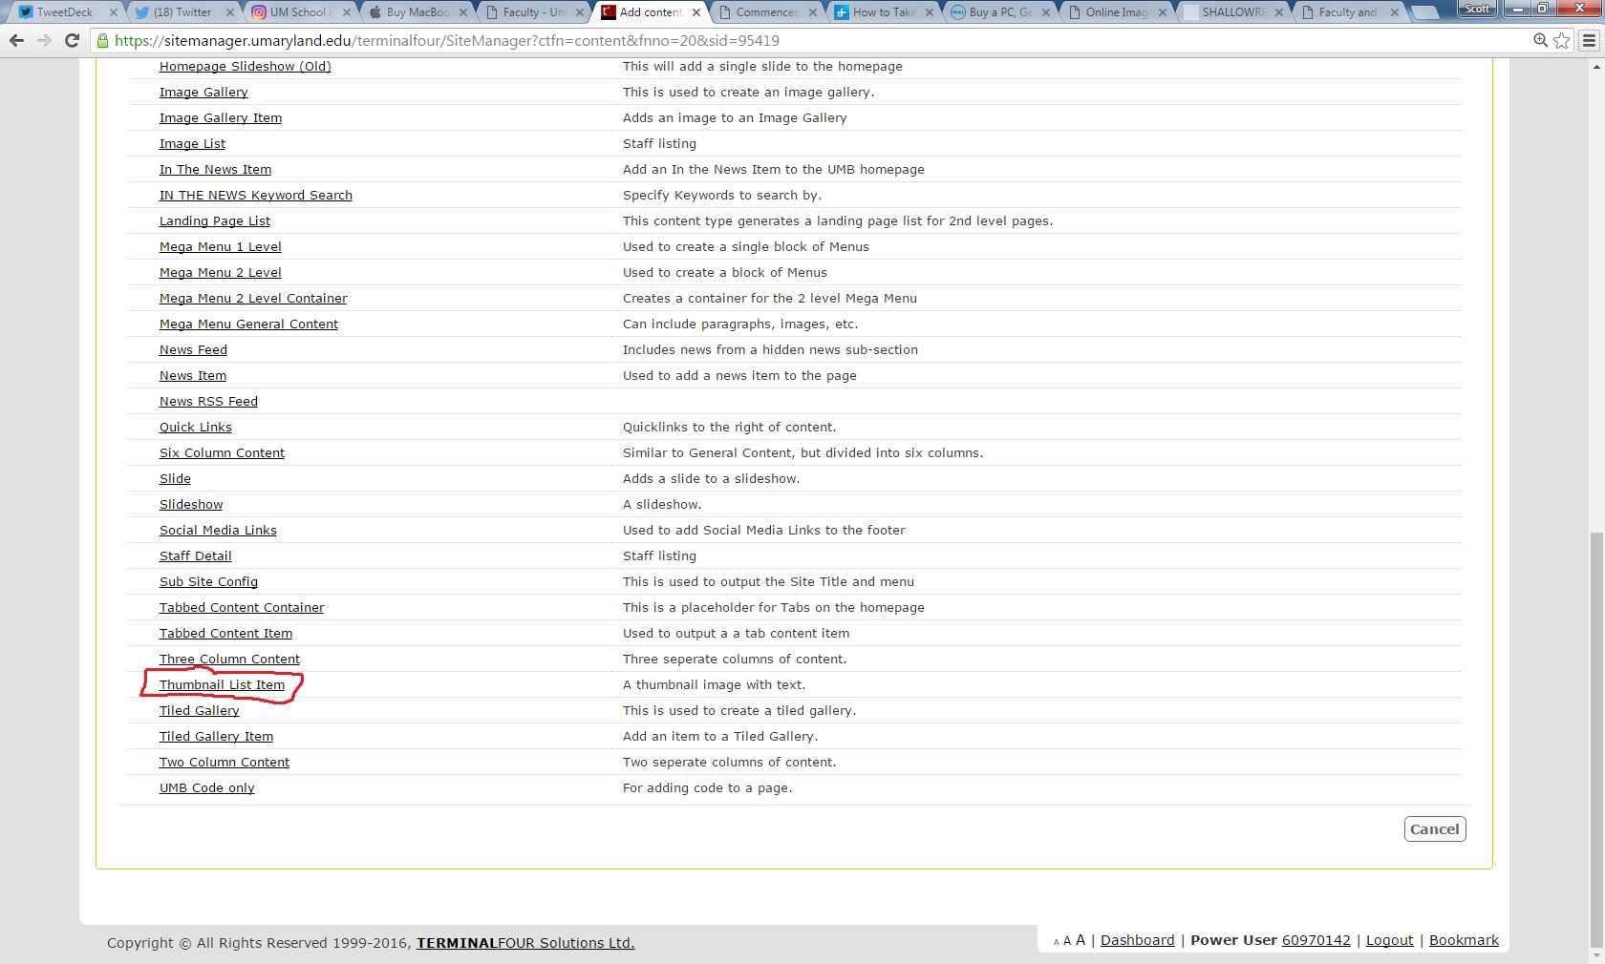
Thumbnail visual guide: content type

Slide 25
Create a thumbnail photo in Pixlr
Follow the same steps as the headshot photo and choose 3:2 ratio for cropping and 170 by 113 px for size.

Slide 26
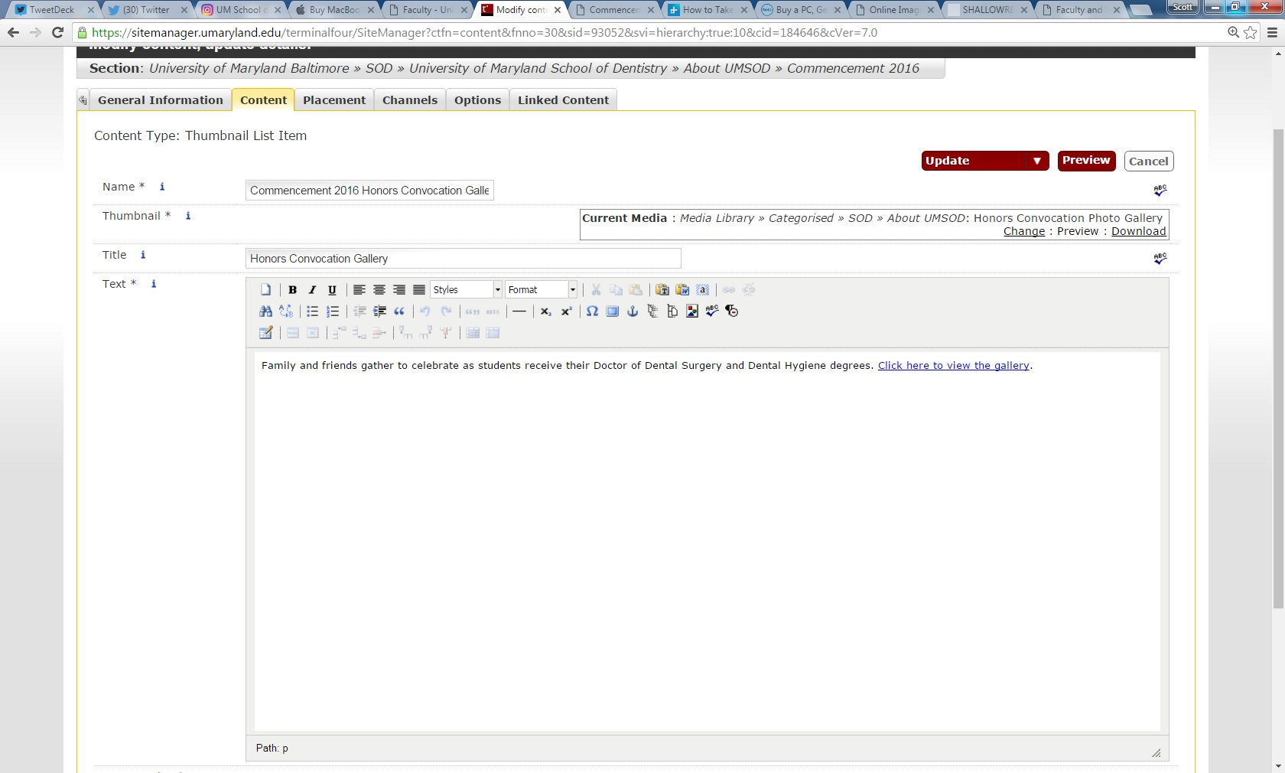
Thumbnail visual guide: entering information

Slide 27
Next steps
We encourage the transition of staff pages into a non-table format over the next two months
Most of the existing staff photos are 180 by 150 px, so you can use those for the three-column pages (the difference between 150 and 144 px will be tiny.)
If you do not wish to use a three column set up, you can use a tiled gallery, which we’ll review in the next meeting.

