Slide 1
Clearing Formatting and Using Expandable Content in T4

Slide 2
Problems that can be fixed by clearing formatting:
Inconsistent font or general font issues
Broken or duplicate photos
Spacing issues

Slide 3
Clearing the formatting provides a clean slate
You will have to re-enter your photos. For text, paragraph breaks and bullet points will be removed. You’ll have to add them back in, but your font will now be in the standard T4 font.

Slide 4
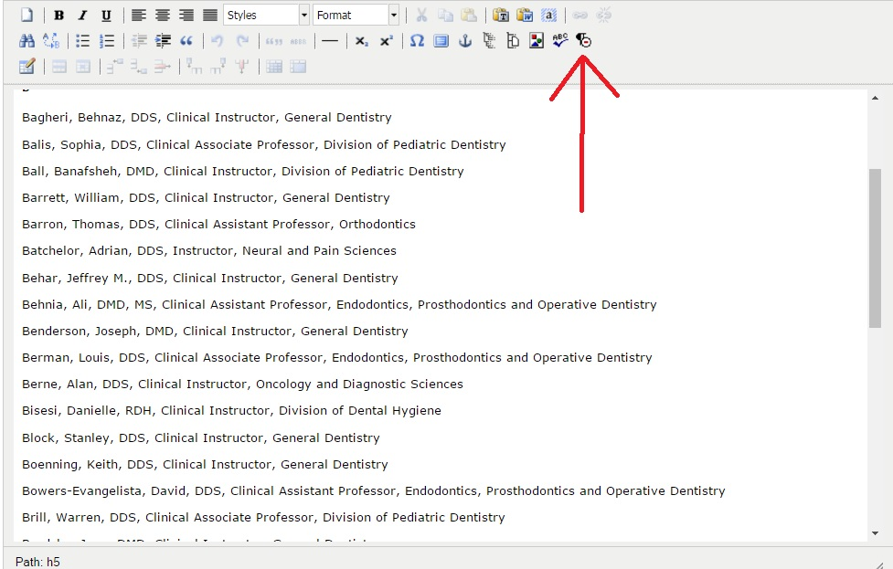
Clear Formatting button

Slide 5
Using Expandable Content
Expandable content can be applied when you have a large department and don’t want a sprawling three-column or thumbnail staff page with photos.
Departments with large administrative units, or a large Dean Faculty contingent, would be appropriate for expandable content.
Expandable content also has multiple uses: if you have a page that includes a lot of content - descriptions of classes or programs, for example - you can avoid bombarding the reader with a wall of text by using expandable pages.

Slide 6
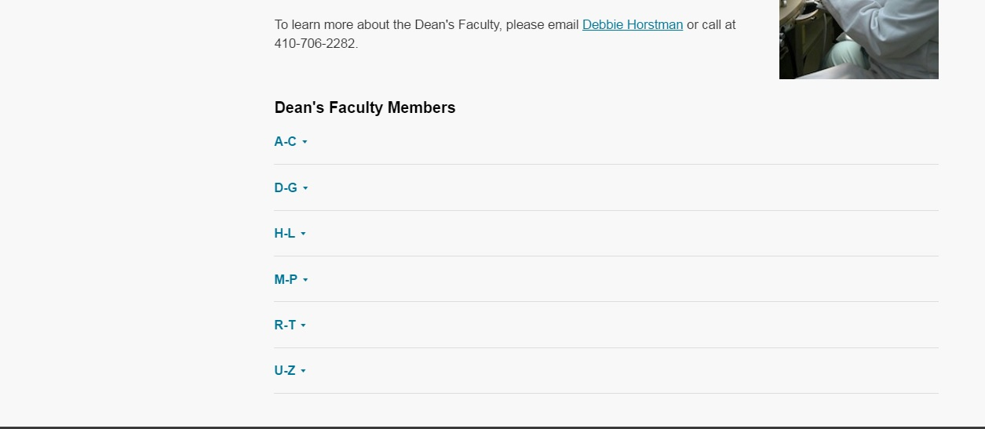
Expandable Page Example

Slide 7
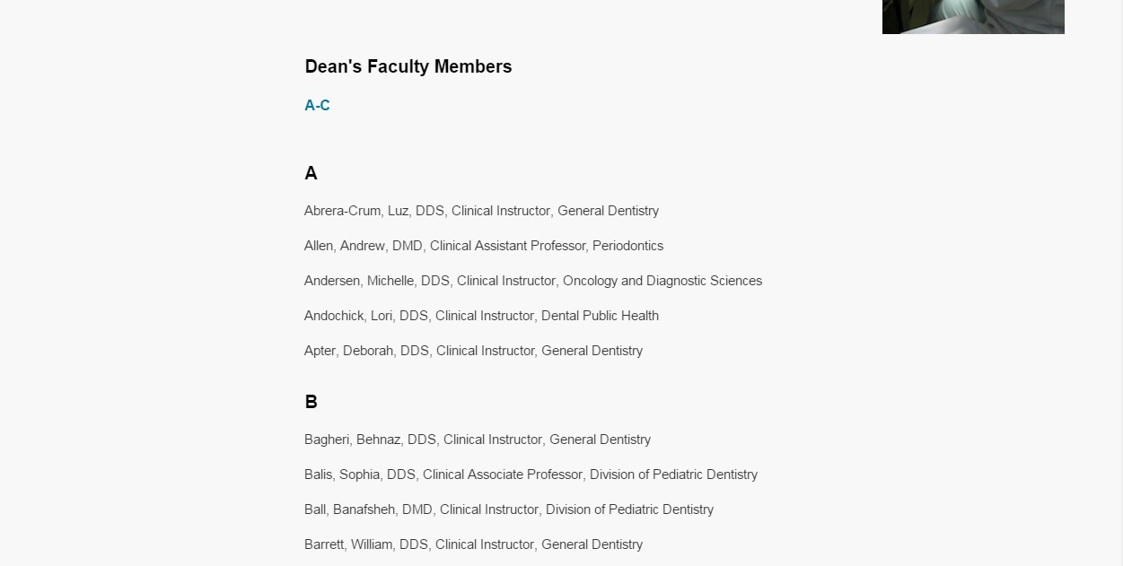
Expanded page example continued

Slide 8
Entering information for expandable content
“Name” category is the internal name for T4
“Header” is what will appear on the page to the reader. The reader can click on this part to expand the content.
“Body” is the text that will appear once you click on the header.

Slide 9
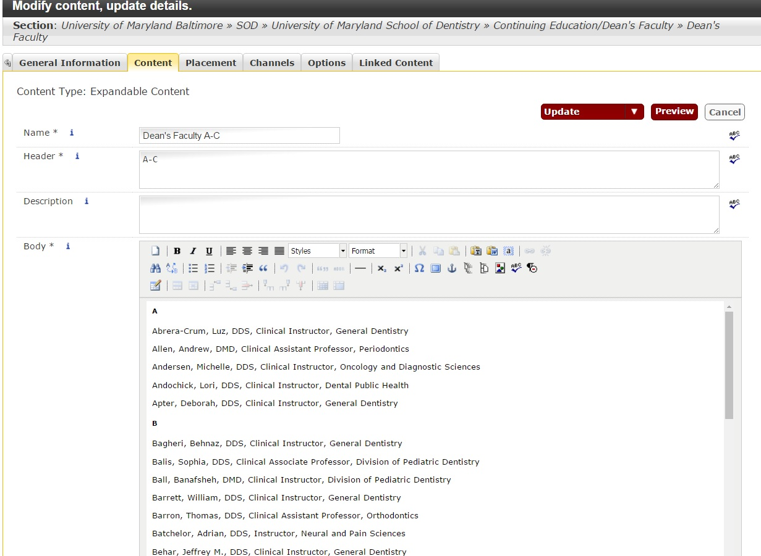
Expandable content: implementing an alphabetical staff page example

Slide 10
You can still create a linkable bio page for individual staff if necessary
Simply highlight the name of an individual and hyperlink to their bio page.
To create an individual bio page, add a section to a faculty or staff folder and then add content for the bio to that section (typically, general content is used).
Examples are on the following page.

Slide 11
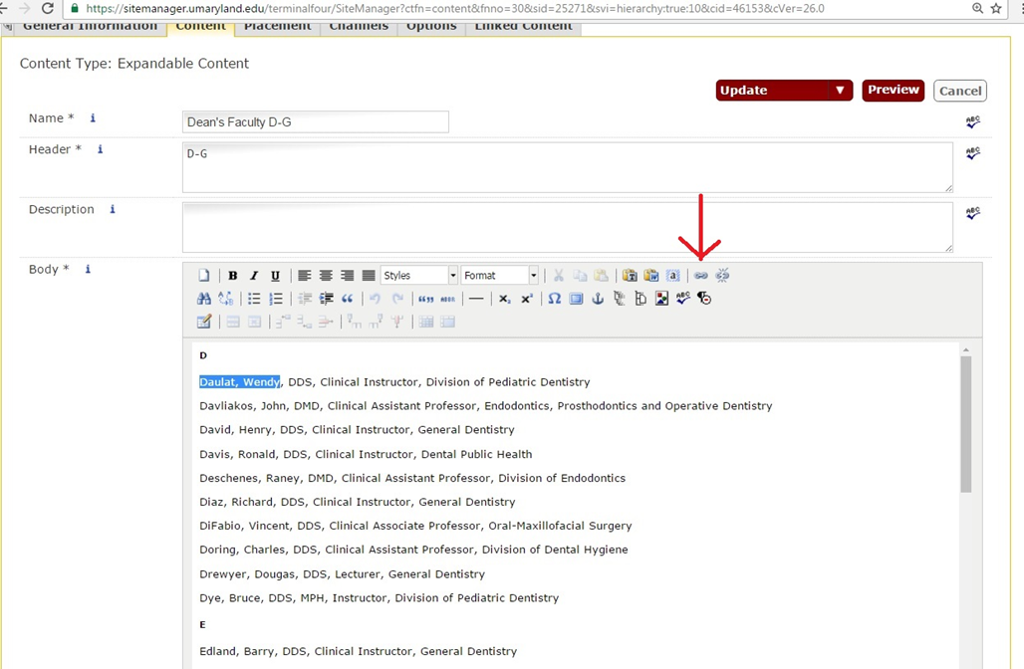

Slide 12
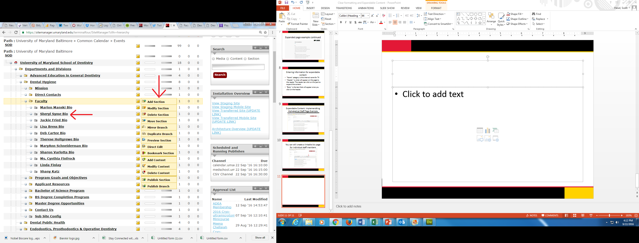
Adding Bio Section

